Slide 1
Final Software Project
Michael Donoghue
Instructor Charmelia Butler
CST 499 Capstone for Computer Software Technology
July 10, 2023

Slide 2

Agenda
SRS Document
UML Design
Website Design
MySQL and Class Registration
PHP Code

Slide 3

SRS Document
Software Requirements Specification (SRS) Document is a roadmap for the project.
An SRS Outlines how the application should operate and how the team will build it (Burak. 2023).
The customer will define their requirements for the project, often through use-case scenarios, conversations, and written statements.
Typically created at the beginning of the project.

Slide 4
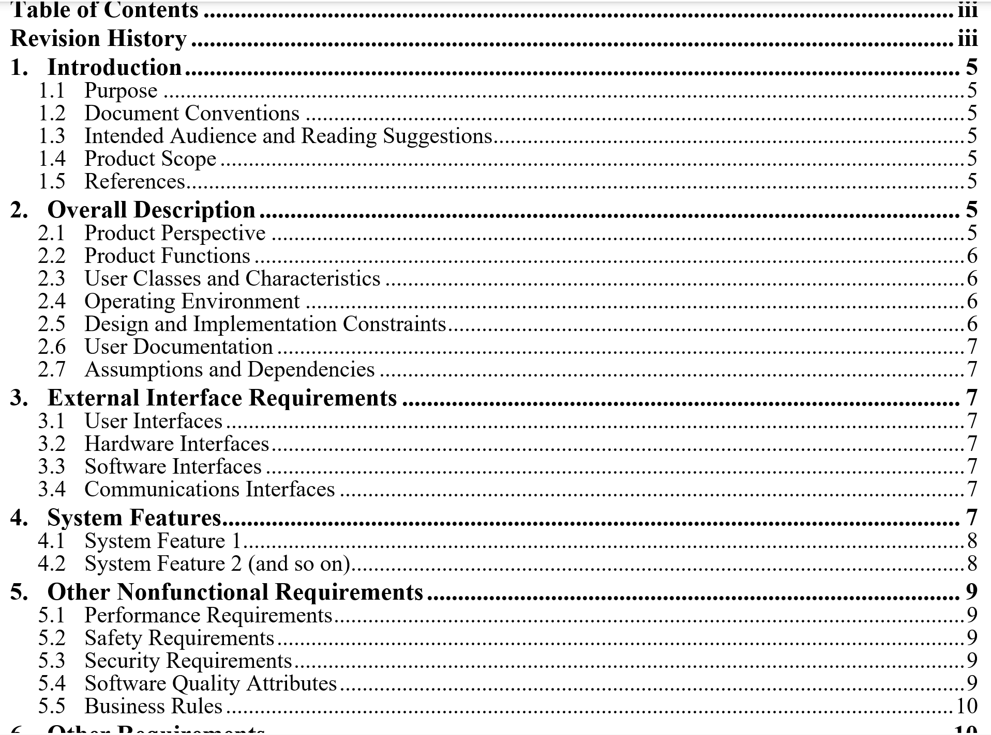
SRS Document
Commonly SRS documents can be built from a template. No strict format, but they cover common topics:
Intro/General overview
Product Description
External interface requirements
System Features (Requirements/Classes/Characteristics)
Non-Functional Requirements and other Requirements
(Wiegers. 1999)

Slide 5
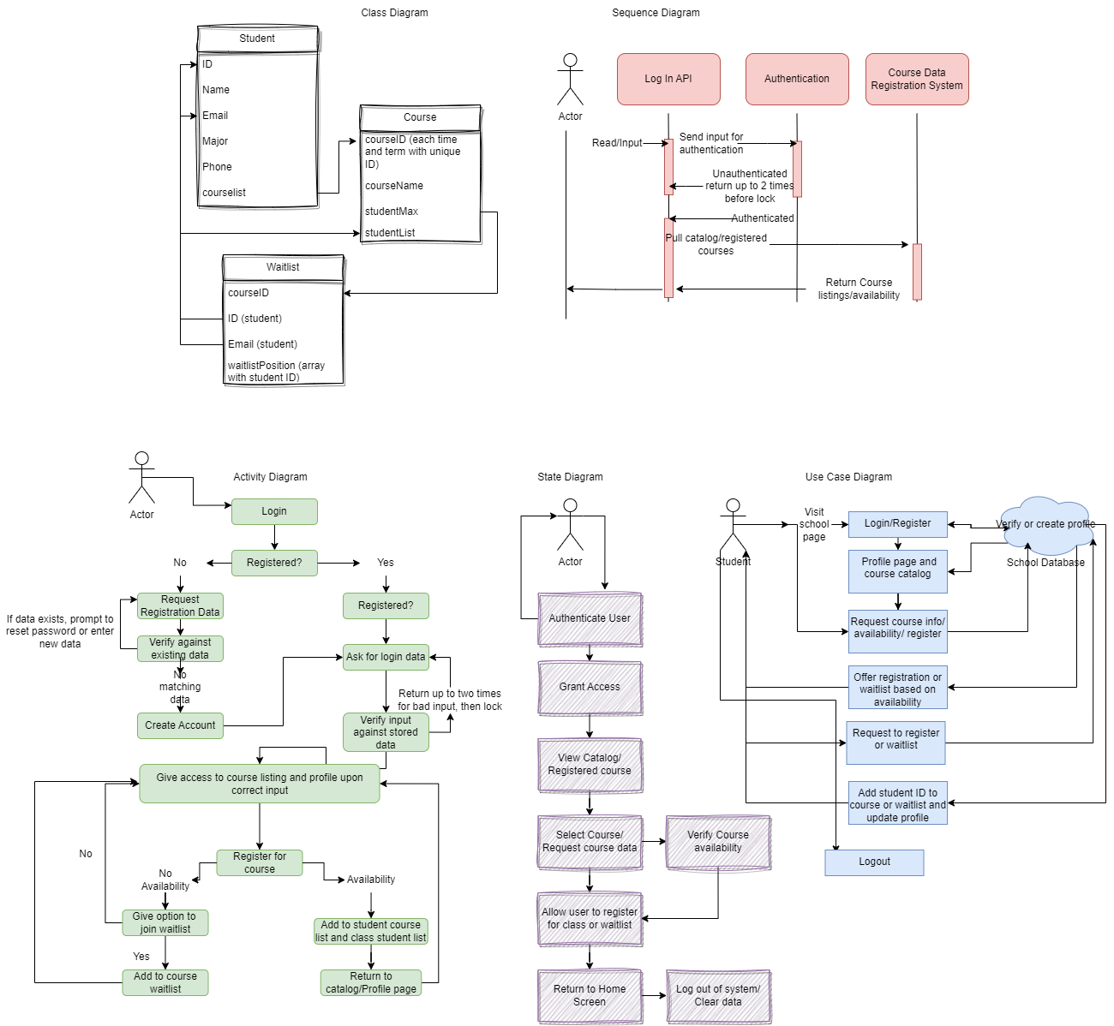
UML Design
Unified Modeling Language (UML) is a way for developers to visualize, document, and construct software systems in an easy-to-understand format (Visual Paradigm. 2023)
Several different types of UML models exist to address different kinds of scenarios.
Some models are meant to show the structure of a system, while others show the behavior of the system.

Slide 6
UML Design
In my UML Design Concept Map, I focused on:
Class Diagram – Describes Object-Oriented Methods, objects, and their relationships.
Activity Diagram – Describes the flow of actions, concurrent actions, user inputs, and system responses.
Structure Diagram – Represents the components of the system and their relationships, not their behavior.
State Diagram – Show the behavior of the system as it passes through various operations and how the objects react.
Use-Case Diagram- Used to display functional requirements and how a user would engage with the program and the options available to them.

Slide 7
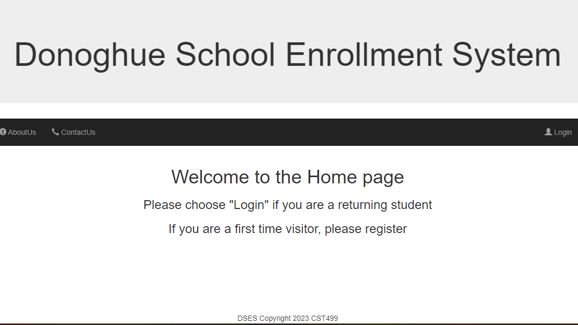
Enrollment System Design
For the site itself, I wanted to create an experience that was easy for the user.
Started with Visual settings from a previous course.
From the home page I made sure proper links were visible to the user based on if they were logged in or not (if a session was established)

Slide 8

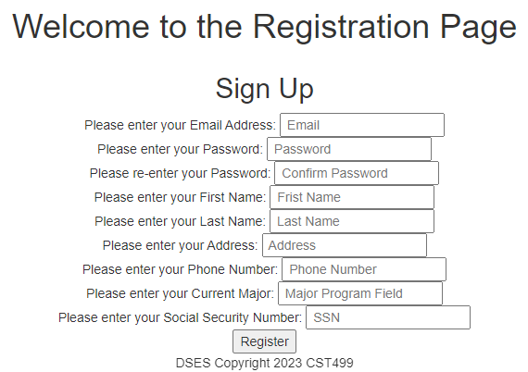
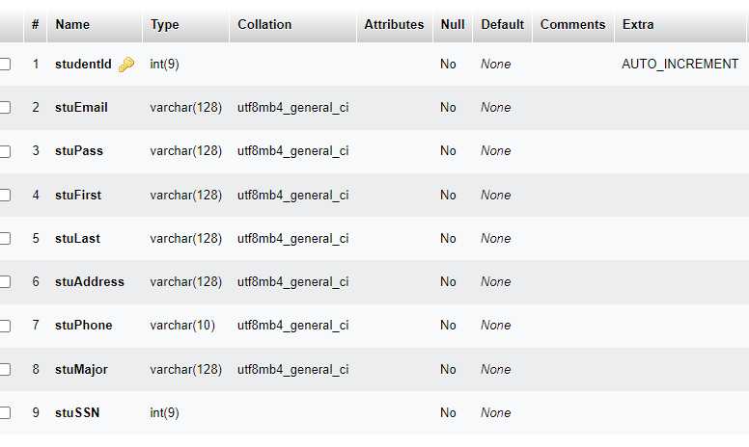
Enrollment System Design
After the landing page was established, I created the HTML Form to accept inputs from the user to register.
With the form established, I also created a database in phpMyAdmin to accept the inputs from the user.
Using functions, I created failsafe checks to ensure inputs were properly formatted, passwords were hashed, no existing user existed with the same information, etc.

Slide 9
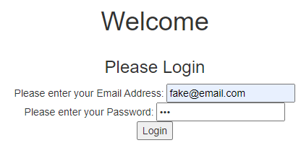
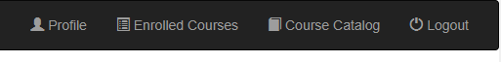
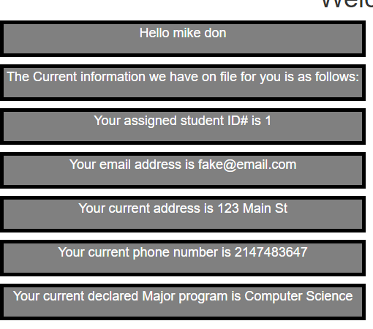
Enrollment System Design
Once registered, the user will visit the Login Page
Login will check that the username and hashed password are accurate. If so, a session will be created.
Header PHP/HTML coding detects if a session has been created and adjusts available navigation options
Takes away registration and log-in and adds, Profile, enrolled courses, and course catalog.

Slide 10
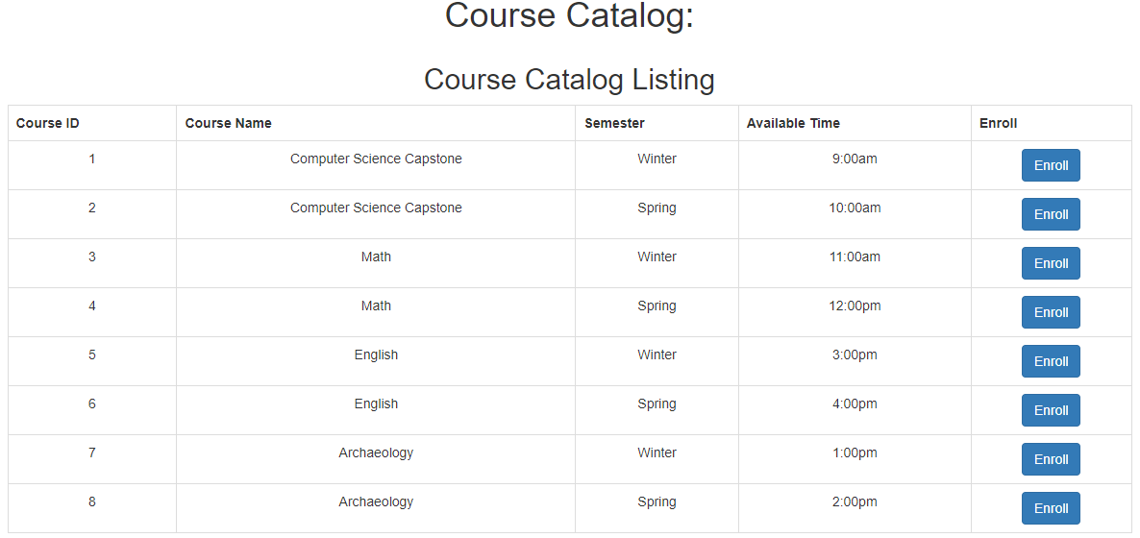
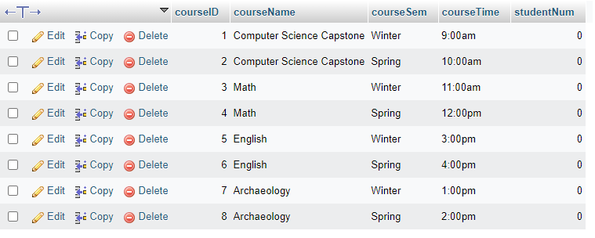
Enrollment System Design
Next Logical Step for the User would be to visit the Course Catalog from the Navigation Bar where they can view available courses.
I wanted to create an enrollment system that allowed enrollment and disenrollment at the push of a button.
Since courses are established and not adjusted by the user, I placed them directly into the database.

Slide 11
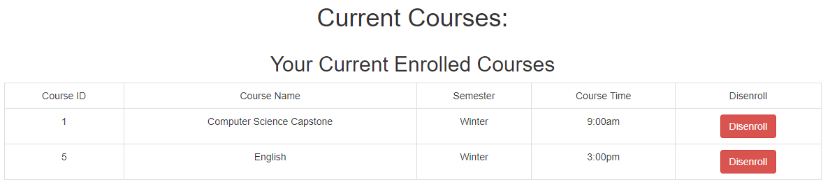
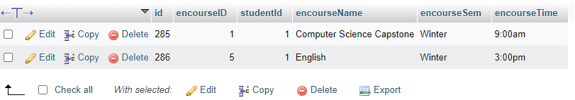
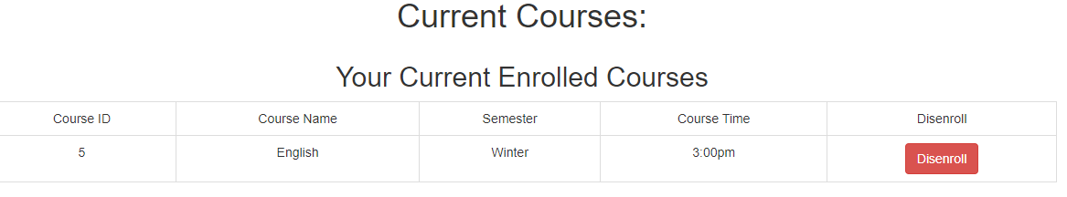
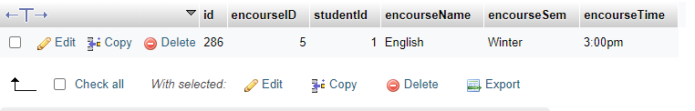
Enrollment System Design
Next step was to create a third database meant to track enrollments, joining data from students and courses.
Once enrolled the student profile would pull course data from the enrollments database attached to the student ID and display it in the student-enrolled courses.
The push of a button would allow disenrolling the student, deleting the connection created in the enrollments database, and removing it from the student profile.

Slide 12




Thank you
Live Demonstration of Site Functionality

Slide 13
References
Burak, A. (2023, March 23). Your 2023 Guide to Writing a Software Requirements Specification (SRS) Document. Relevant. Retrieved July 1, 2023, from https://relevant.software/blog/software-requirements-specification-srs-document/
Visual Paradigm. (2023). What is Unified Modeling Language (UML)? Visual Paradigm. Retrieved July 1, 2023, from https://www.visual-paradigm.com/guide/uml-unified-modeling-language/what-is-uml/
Wiegers, K. E. (1999). Software requirement specifications for <project> [Template]. https://web.cs.dal.ca/~hawkey/3130/srs_template-ieee.doc

